Slide 1
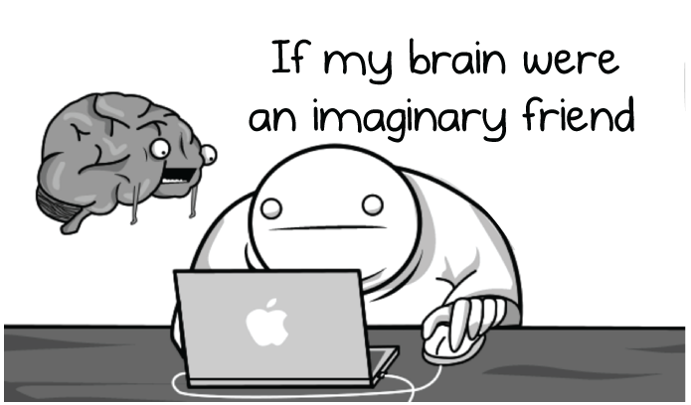
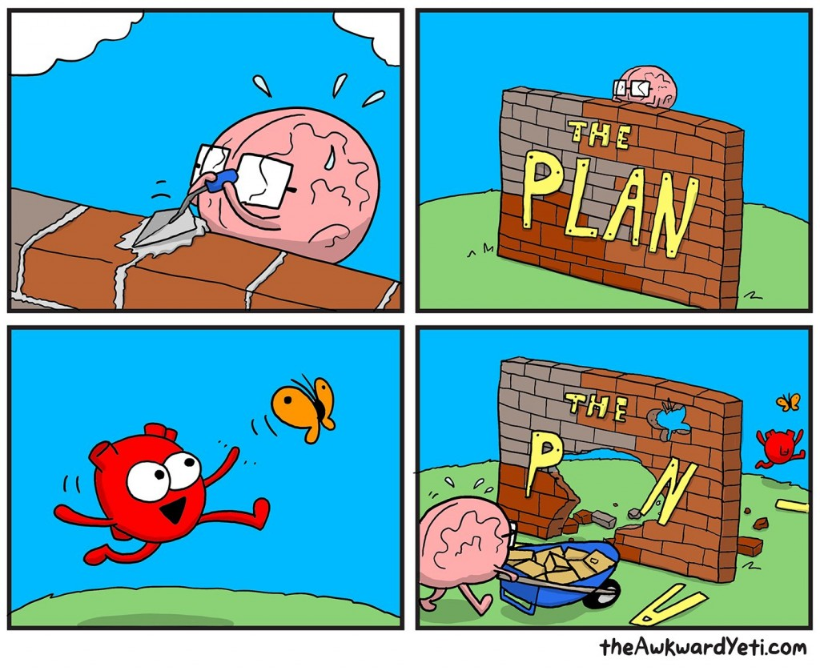
theoatmeal
Notes:
Done

Slide 2
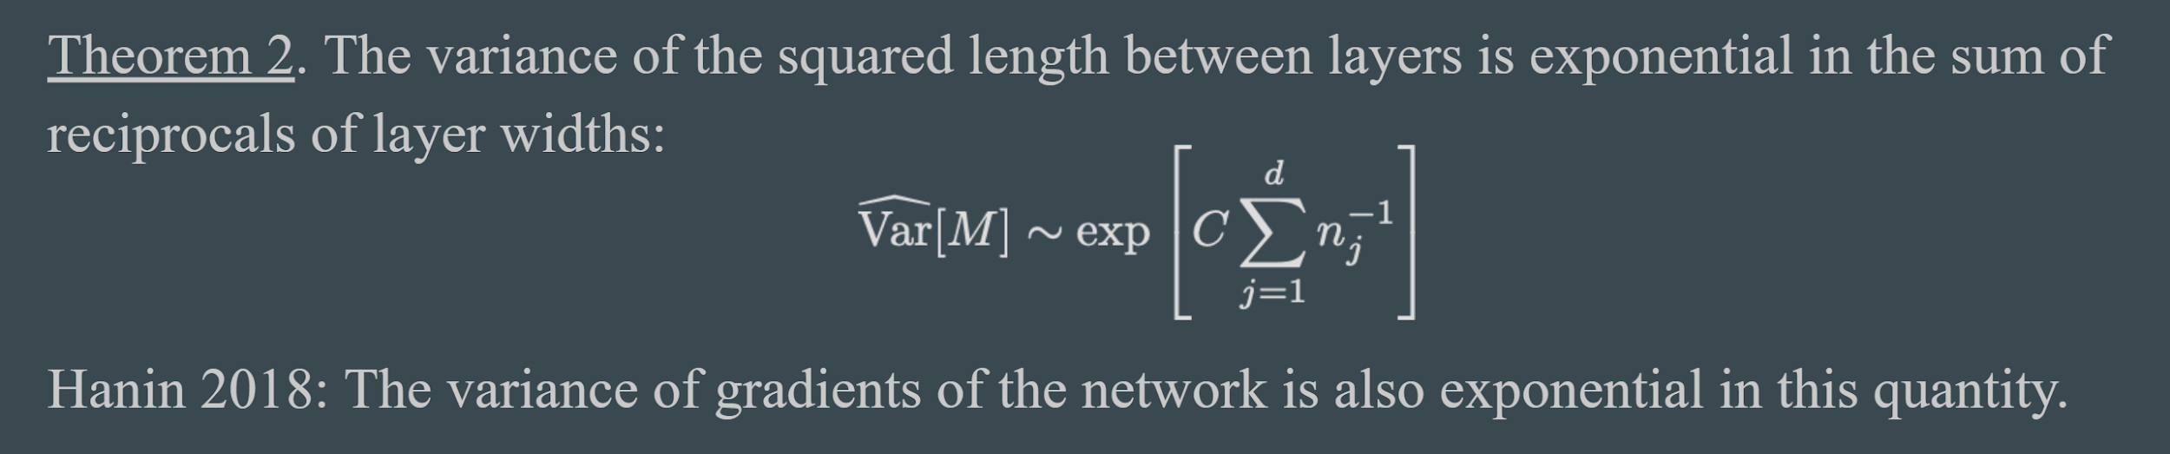
A quick note about Homework 2
Recall from David's lesson on deep vs. shallow learning (Lecture 4M) that training speed is optimized when layer widths are uniform.
So why is autoencoding useful?

Slide 3
A quick note about Homework 2
Recall from David's lesson on deep vs. shallow learning (Lecture 4M) that training speed is optimized when layer widths are uniform.
So why is autoencoding useful?
Allows for self-supervised learning (increases size of dataset), allows for a principled shared module between learning tasks, and decreases number of weights in a model.

Slide 4
A quick note about Homework 2
What if my colors are all #@^!'ed up?

Slide 5
A quick note about Homework 2
What if my colors are all #@^!'ed up?
Increase your number of features (aka channels). You start out with 3 (RGB).
What if my image is too blurry?

Slide 6
A quick note about Homework 2
What if my colors are all #@^!'ed up?
Increase your number of features (aka channels). You start out with 3 (RGB).
What if my image is too blurry?
Increase your encoding's spatial dimension by a bit.
Or increase your number of features by a lot.
What if it's still garbage?

Slide 7
A quick note about Homework 2
What if my colors are all #@^!'ed up?
Increase your number of features (aka channels). You start out with 3 (RGB).
What if my image is too blurry?
Increase your encoding's spatial dimension by a bit.
Or increase your number of features by a lot.
What if it's still garbage?
Try using pooling, a nonlinearity, or batchnorm.
Add a linear layer at the end of your encoding.

Slide 8
A quick note about Homework 2
What do we mean by additive properties over vectors?

Slide 9
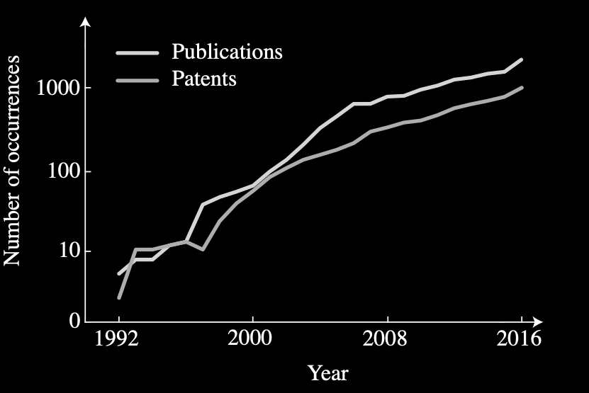
ML is becoming popular across Neuro and Biomedical
With Josh Glaser, Roozbeh Farhoodi, Ari Benjamin

Slide 10
CIS 700-004: Lecture 13M
Neuroscience, Part I
4/8/19
Notes:
Done

Slide 11
Part 1: Why DL needs neuroscience/ cognitive science
Intelligence is quite complicated
Many good ideas come from observing intelligent behavior
Brains are among the main generators of such behaviors

Slide 12
What may we wish to learn?
The four big questions: architecture, objective, optimizer, and dataset
Architecture: Depth, shape, modalities, flow of learning signals, attention, memory, reasoning, mental rehearsing
Objective: Unsupervised objectives, causality, affordances, relevance, curiosity
Optimizer: Anything that is really really fast
Dataset: Curriculum learning, culture

Slide 13
A remarkable concentration of neuroscientists/ cognitive scientists
Geoffrey Hinton
Yann LeCun
Michael Jordan
Emo Todorov
Zoubin Ghahramani
Yoshua Bengio
Ian Goodfellow
Joshua Tenenbaum
Tim Lillicrap
Greg Wayne
Simon Osindero
Barak Pearlmutter
Demis Hassabis

Slide 14
Part 2
Neuroscience failure modes: why it needs deep learning
Notes:
Done

Slide 15
The goals of neuroscience
Make brain computation human understandable
Produce models that actually work
Get at principles
Understand some aspects
Problem 1: are we really getting at the right insights?

Slide 16
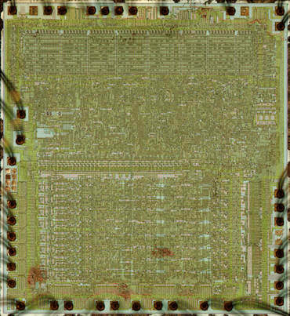
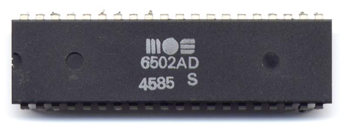
Microprocessor
With Eric Jonas

Slide 17
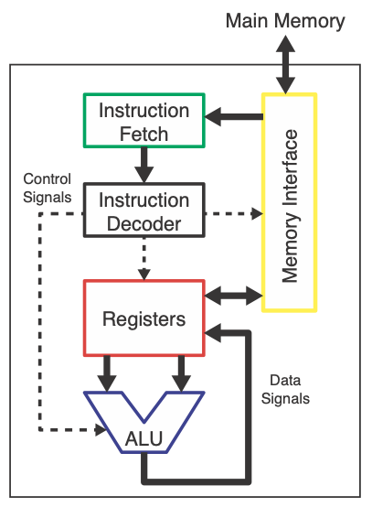
How it works

Slide 18
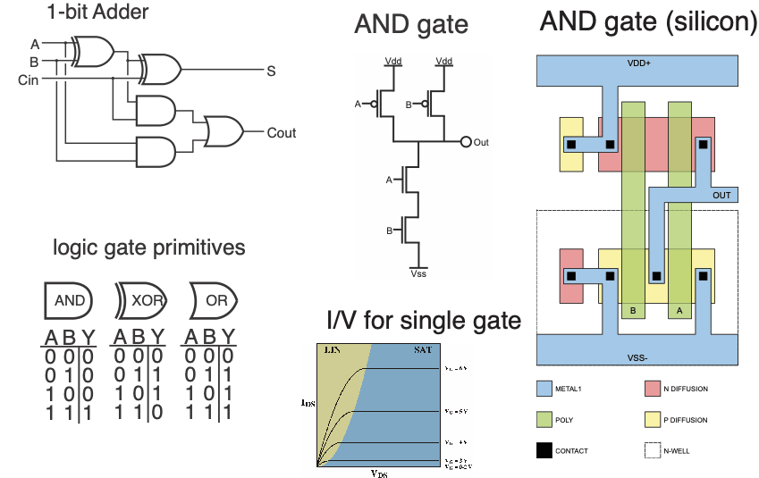
Multiple layers of abstraction

Slide 19
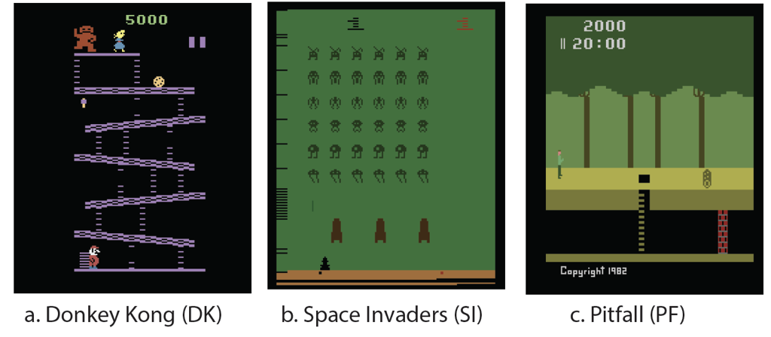
3 Behaviors

Slide 20
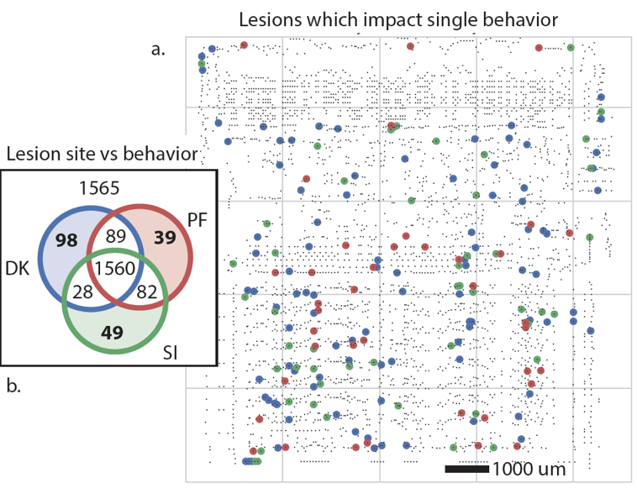
Lesion studies - does it boot?

Slide 21
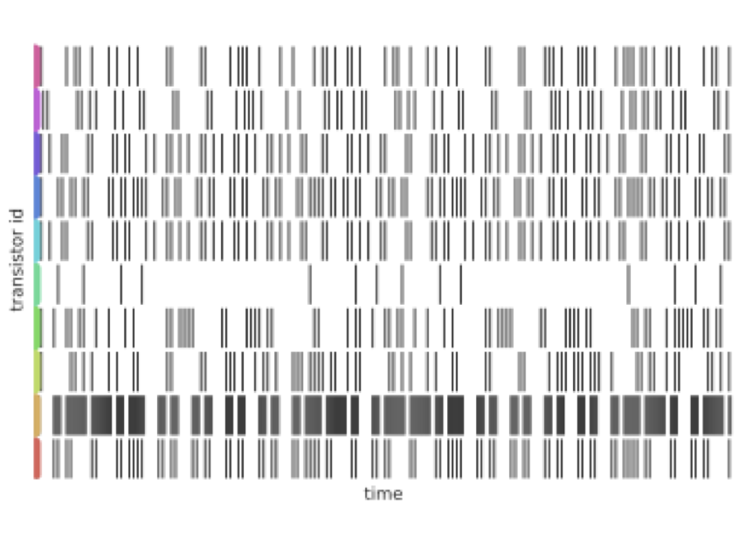
Spike data (off-on transitions)

Slide 22
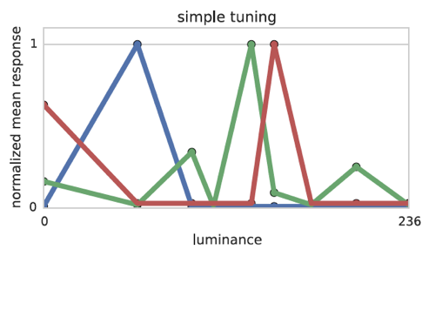
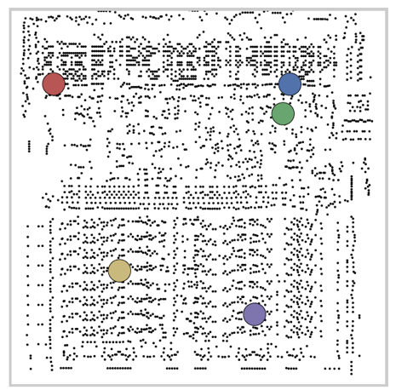
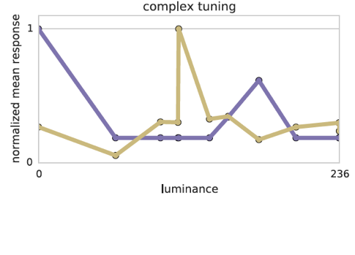
Tuning curves

Slide 23
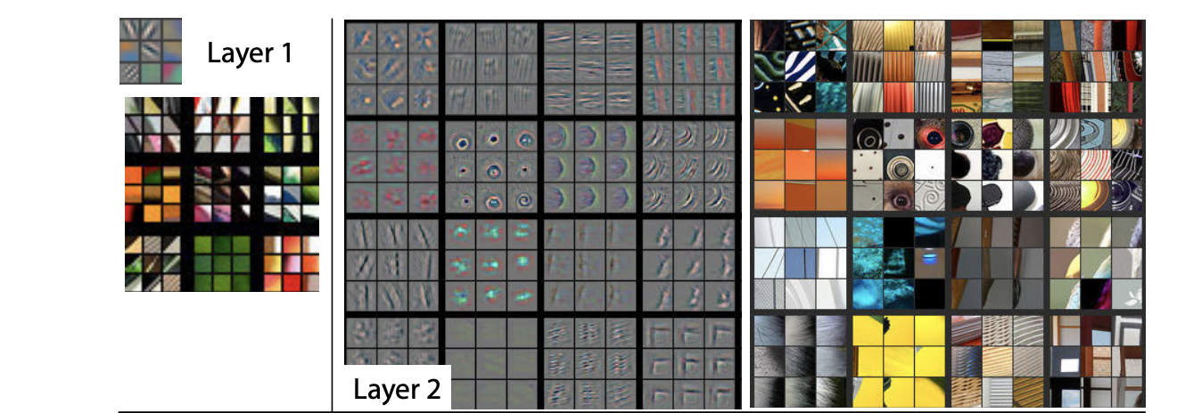
Visualize tuning in DL
Unpooling, and transposes
Zeiler Fergus

Slide 24
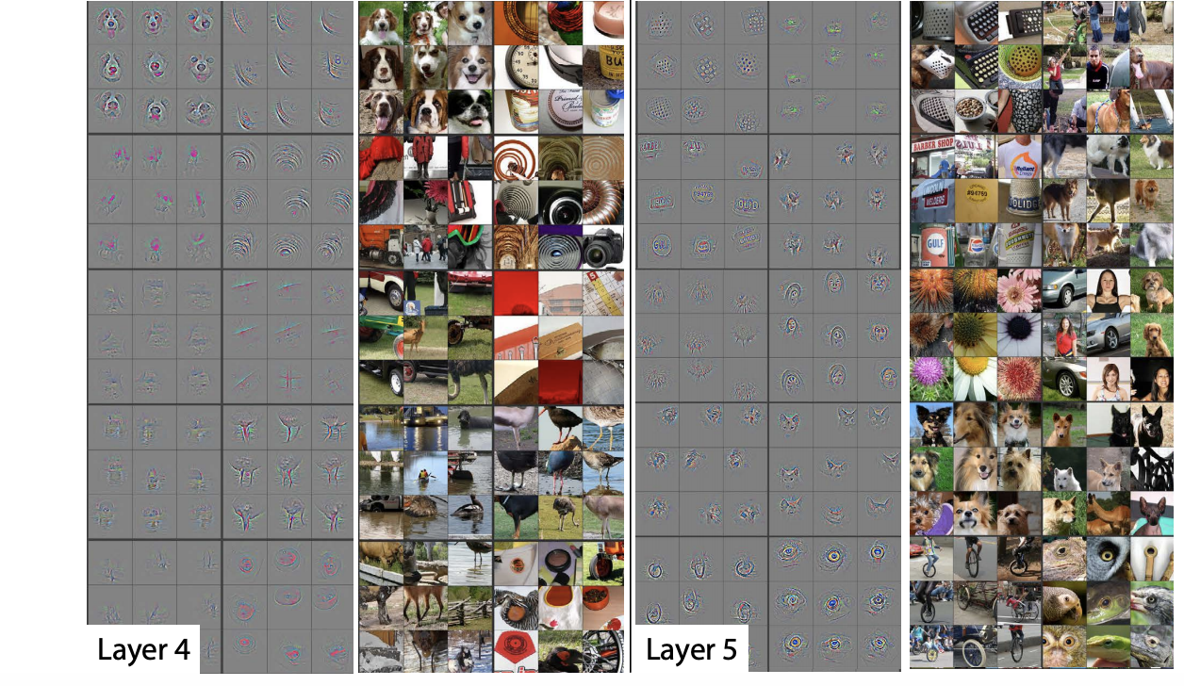
Do we understand them?

Slide 25
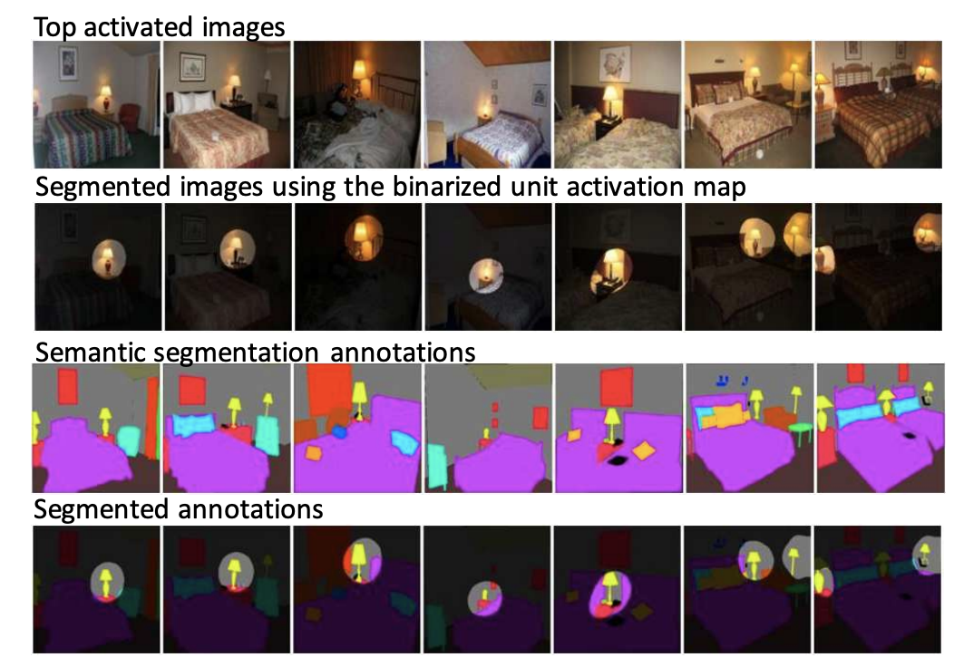
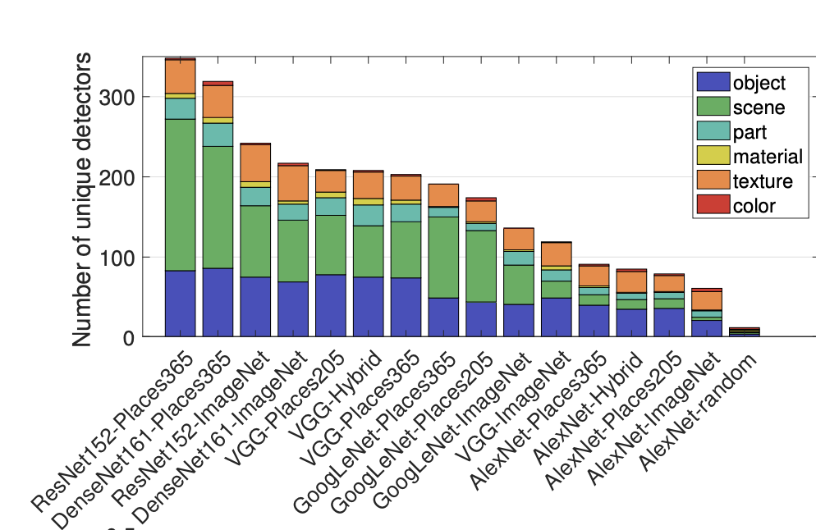
Meaning space?
Zou, Bau, Oliva, Torralba

Slide 26
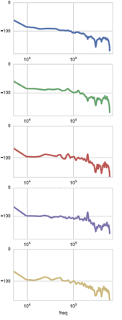
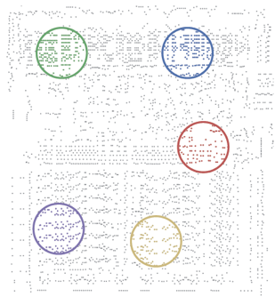
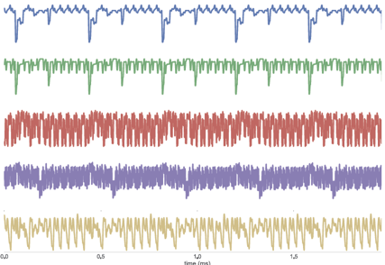
LFPs and Power spectra

Slide 27
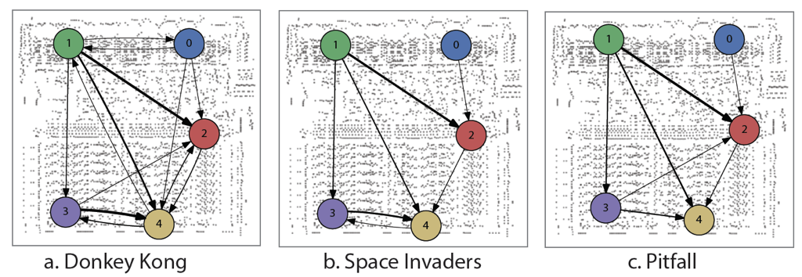
Granger causality

Slide 28
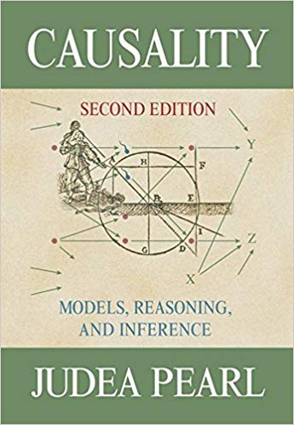
A short aside on causality
In a week we will spend
all Monday on causality

Slide 29
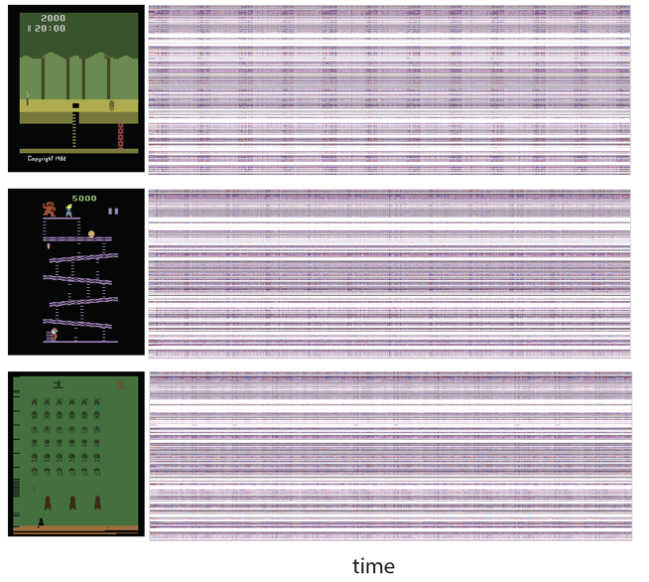
Record everything

Slide 30
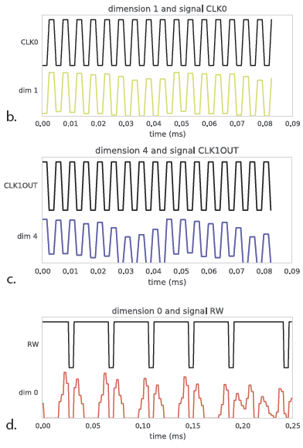
Nonnegative matrix factorization

Slide 31
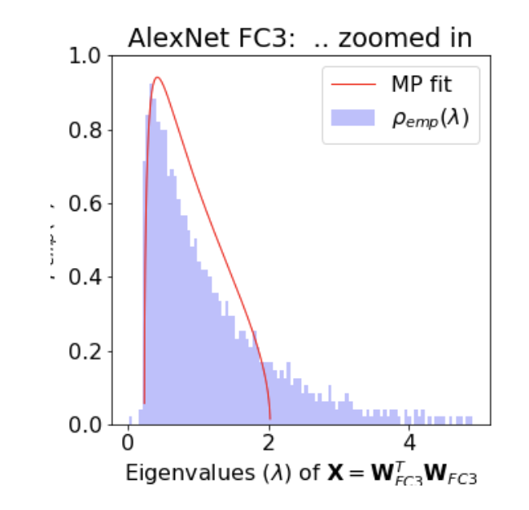
Matrix factorization of DL systems
Also relevant for
Learning speed
Generalization
Relates to regularization
CalculatedContent.com

Slide 32
Let us get back to what we mean with understand
Model explainable to humans
Model works

Slide 33
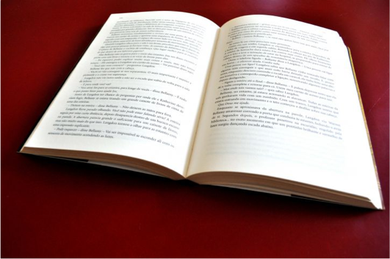
Human understandable

Slide 34
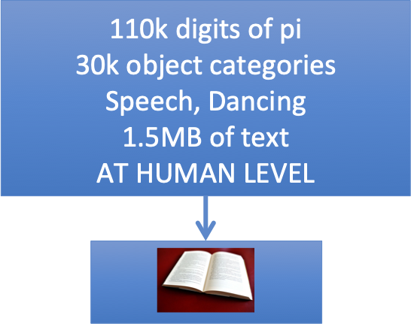
What it takes for a model to be eligible

Slide 35
Compressing solutions to imagenet
Start with MobileNet 0.5
Dynamic network surgery -> 60% performance
Codebook
350kB
Also: yields PAC Bayes generalization bounds
Zhou, Veich, Austern, Adams, Orbanz

Slide 36
Incompressibility conjecture
A model that can solve human like problems
Can not be compressed small enough (Kolmogorov Complexity)
So that a human can understand it

Slide 37

Tic Tac Toe
255,168 distinct games!

Slide 38
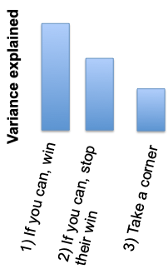
Intuition about compressibility

Slide 39
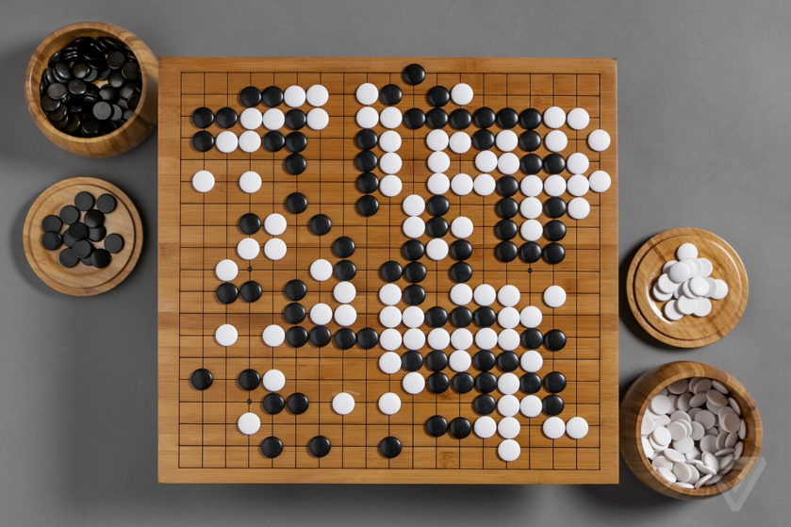
Go

Slide 40
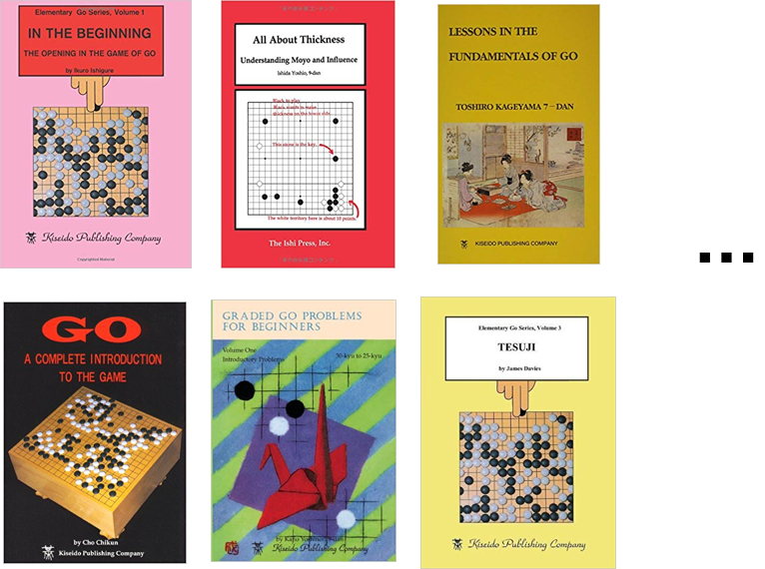
Maybe not compressible

Slide 41
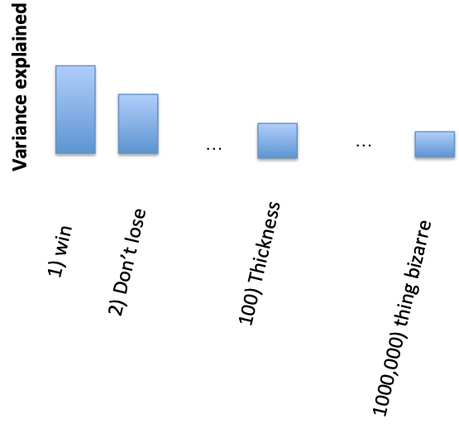
Rules for good go playing

Slide 42
Where is the information from?
Environment:
~10 bits/second - pi*10^7 seconds/y
30 years
10^4 books
DNA:
6*10^9 upper bound
Most is non CNS
Very uncompressed

Slide 43
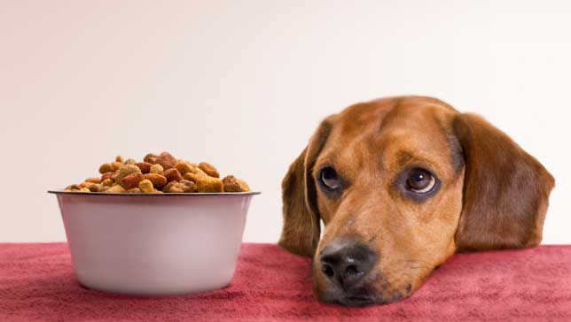
Meaningful world models
Problems with deep learning:
Learning one mode of data (e.g. images) ≠ learning another (e.g. NLP)
Not robust to semantically unimportant changes (e.g. background color)
No theory of mind
Cannot infer & solve new tasks
From the cognitive side, we don’t understand how humans do these things

Slide 44
The generator triplet
Anatomy
Objective functions
Optimizers

Slide 45
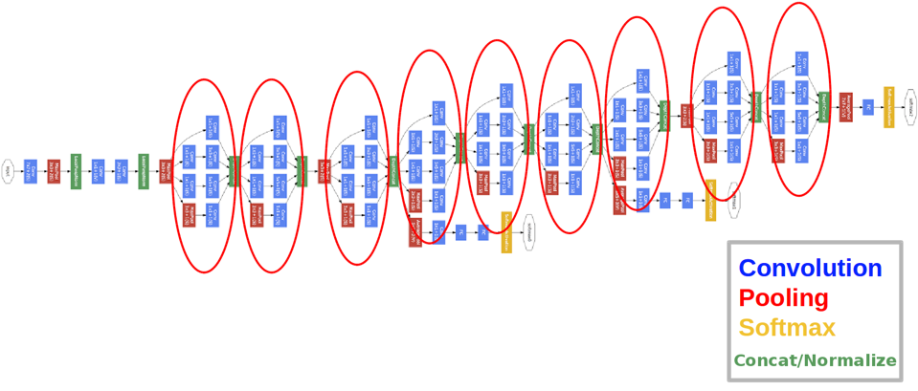
Anatomy

Slide 46
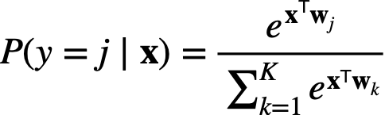
Objective function

Slide 47
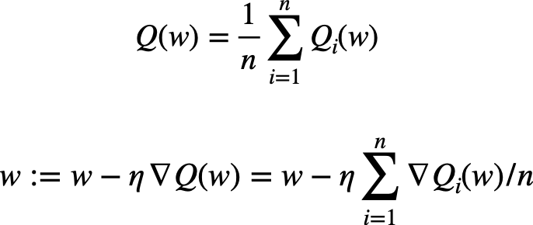
Optimizers

Slide 48
A convergent evolution?

Slide 49
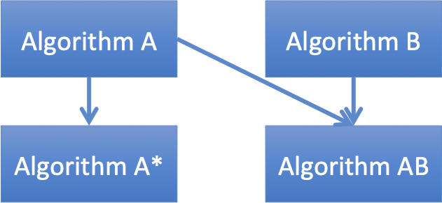
Evolution as the source of DL algorithms

Slide 50
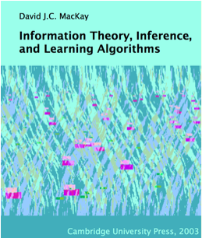
Evolution can be quite efficient

Slide 51



A simple model
Mutations
Randomly flip bits
Better half survives
Reaches perfect f=1 in
Generations
Crossover
Randomly inherit bits
Better half survives
Reaches perfect f=1 in
Generations

Slide 52
Conjecture
Biological algorithms will generally have great sample complexity
We can do *much* better than (MacKay) evolution.
Evolution probably does

Slide 53
Evolved tricks
Differentiable
Backpropagation
SGD
Skip connections
Batch norm
Adaptive step size
Early stopping
Dropout
Gradient clipping
Learning rate hacking
Convolutions
Optimize Architecture
Domain adapt

